Slide 1
SmART STUDY PLANNER
CAPSTONE PROJECT
Presented By:
Parasa Pujitha-Seshadri Rao Gudlavalleru Engineering College-Computer Science and Engineering

Slide 2
OUTLINE
Problem Statement (Should not include solution)
System Development Approach (Technology Used)
Algorithm & Deployment (Step by Step Procedure)
Result
Conclusion
Future Scope(Optional)
References

Slide 3
Problem Statement
Students often struggle with organizing their study schedules, deadlines, and daily learning tasks.
Existing planners are either too complex, require paid subscriptions, or lack personalization.
There is a need for a simple, lightweight, and interactive study planner that helps students:
Manage tasks effectively
Visualize deadlines on a calendar
Track progress
Stay motivated with reminders

Slide 4
System Approach
Frontend Technologies:
HTML5 – Structure of the webpage
CSS3 – Styling and responsive layouts
JavaScript – Dynamic interactivity (tasks, reminders, progress tracking))
Design Approach:
Clean and user-friendly interface
Drag-and-drop support for tasks
Color coding for categories and priorities
LocalStorage for persistent data (offline support)

Slide 5
Algorithm & Deployment
Task Creation
User enters task details (name, date, time, category, priority).
Data Storage
Save tasks in localStorage for persistence.
Calendar Rendering
Display monthly calendar with tasks on respective dates.
Highlight today’s date.
Task Management
Drag-and-drop to edit task dates.
Right-click to delete tasks.
Mark tasks as completed.

Slide 6
Algorithm & Deployment
Upcoming Tasks & Progress
Display tasks due today + next 7 days.
Progress bar updates based on completed tasks.
Reminder S
Mobile responsiveness
Deployment
Host using GitHub Pages / Netlify for free and easy access.

Slide 7
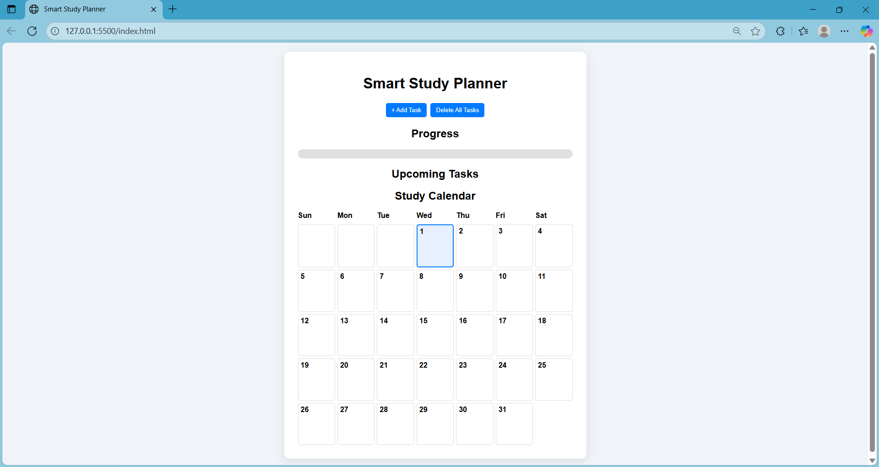
Result

Slide 8
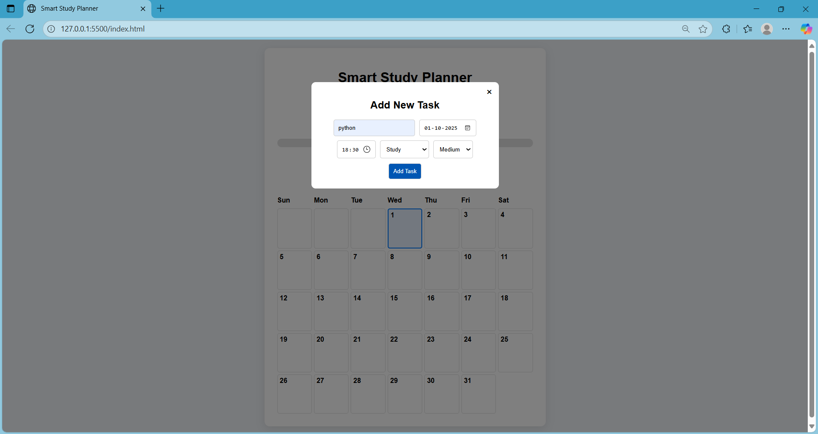
Result

Slide 9
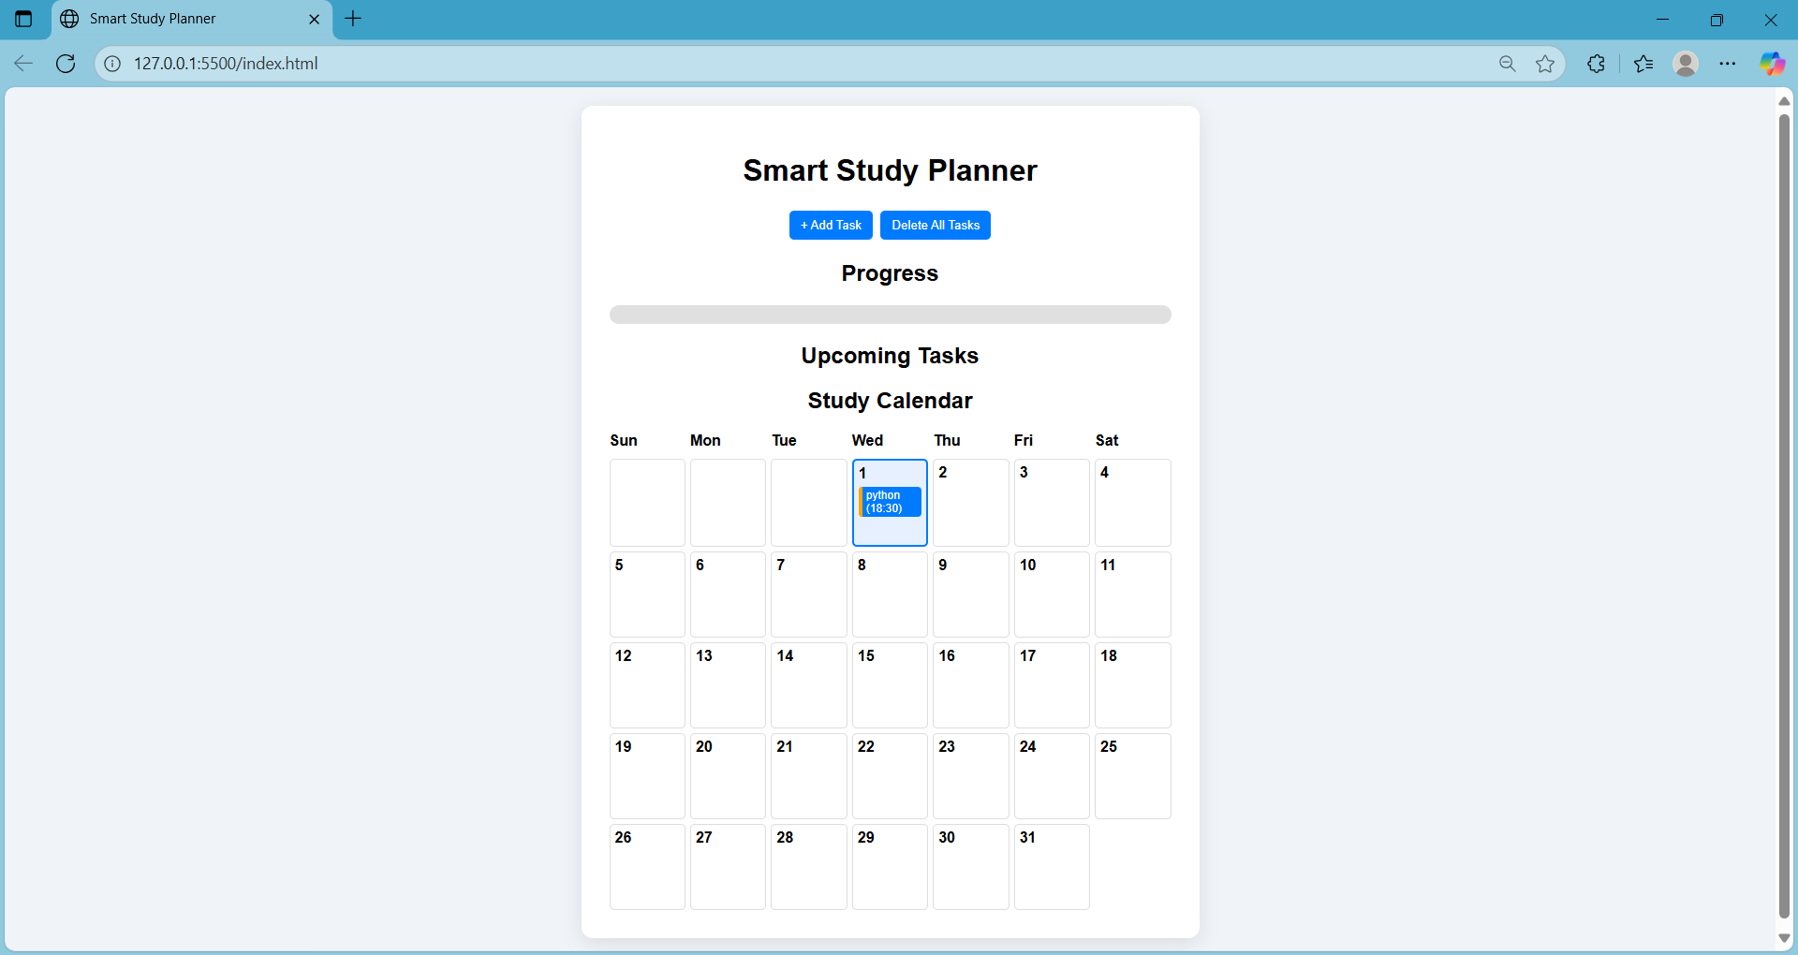
Result

Slide 10
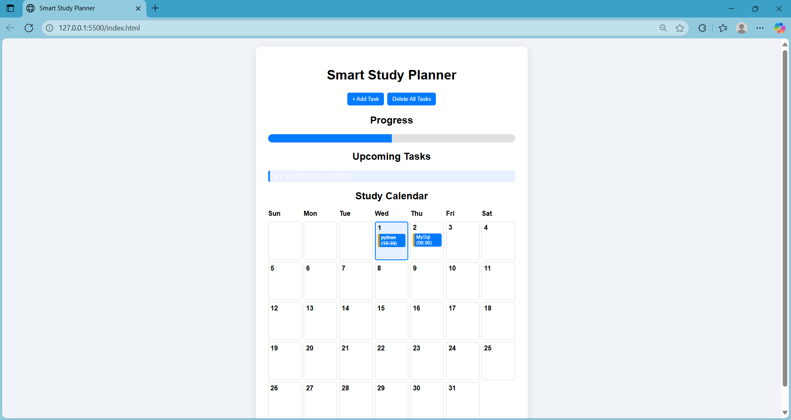
Result

Slide 11
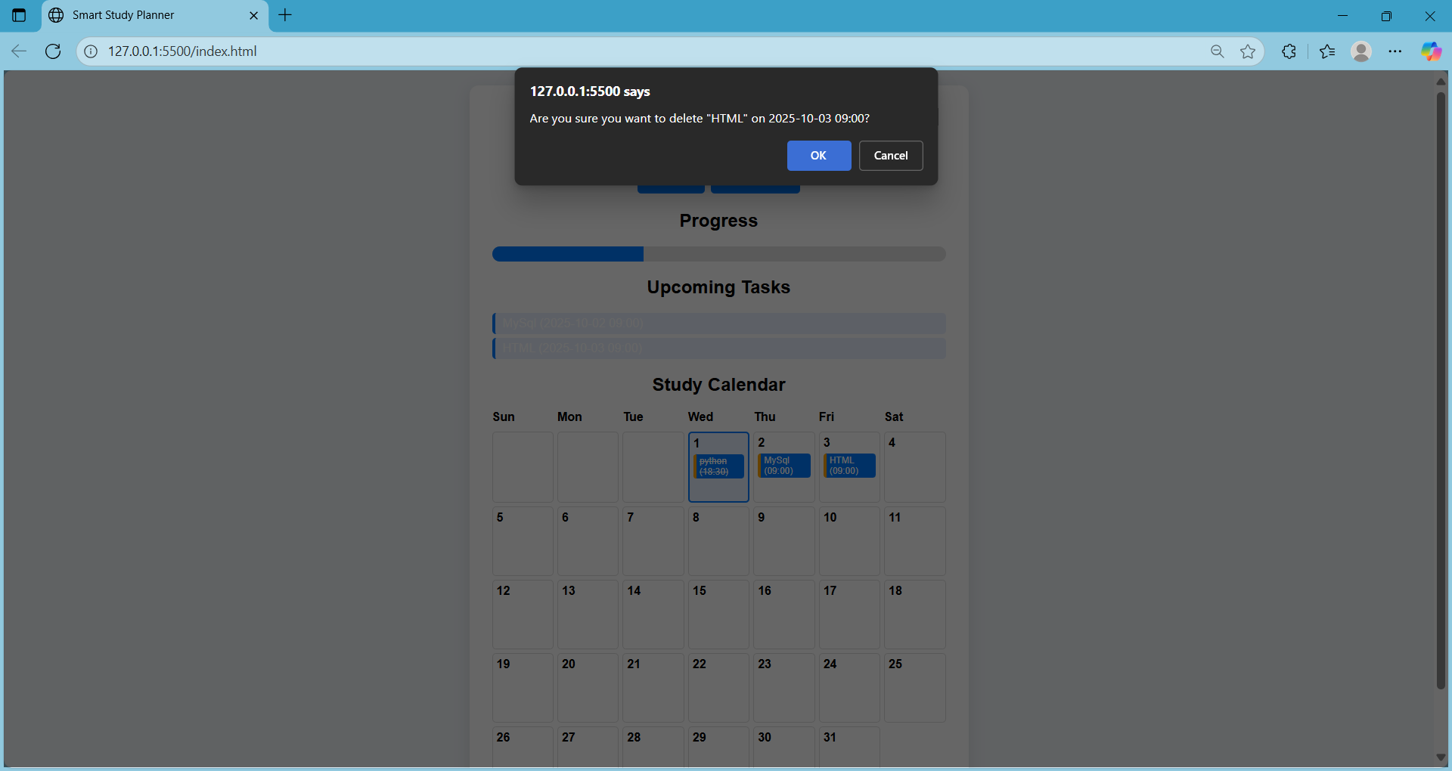
Result

Slide 12

Result

Slide 13
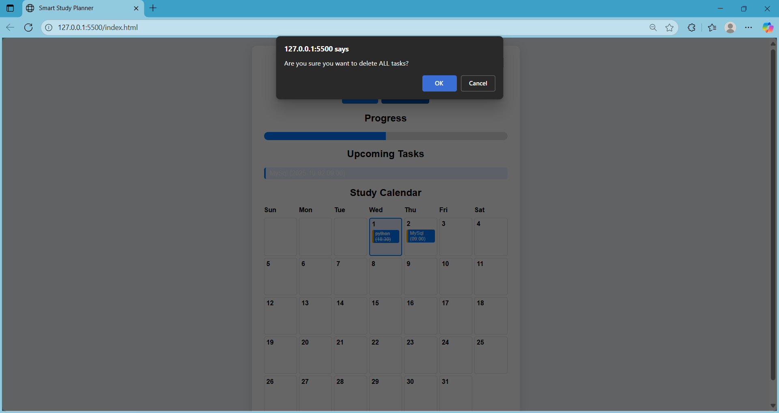
Result

Slide 14

Result

Slide 15
GITHUB AND DEPLOYMNET LINK
Attach your Github Link : https://github.com/pujithaparasa/SmartStudyPlanner

Slide 16
Conclusion
Provides an easy-to-use and efficient study planner for students.
Eliminates dependency on complex or paid applications.
Helps students stay organized, motivated, and consistent in learning.

Slide 17
Future scope(Optional)
Cloud integration for cross-device syncing..
User authentication & personalized profiles.
AI-powered smart study suggestions.
Mobile app version.
Integration with Google Calendar & notifications.

Slide 18
References
List and cite relevant sources, research papers, and articles that were instrumental in developing the proposed solution.
GitHub Repository: https://github.com/pujithaparasa/SmartStudyPlanner
JavaScript Documentation (MDN Web Docs)
Bootstrap & UI design resources

Slide 19
THANK YOU

